Slide 1
Flight Delays
Final Machine Learning Project
Dale George, Siqing Cao, Peyton Harsh, and Bianca Garcia
2020

Slide 2
Which airline should I take in January 2021?

Slide 3
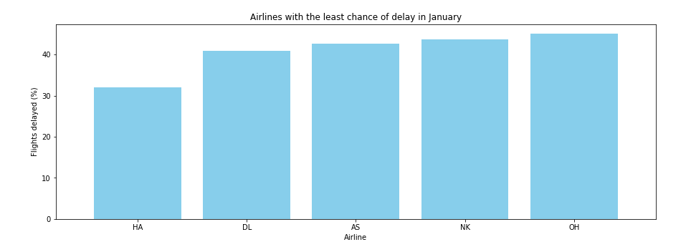
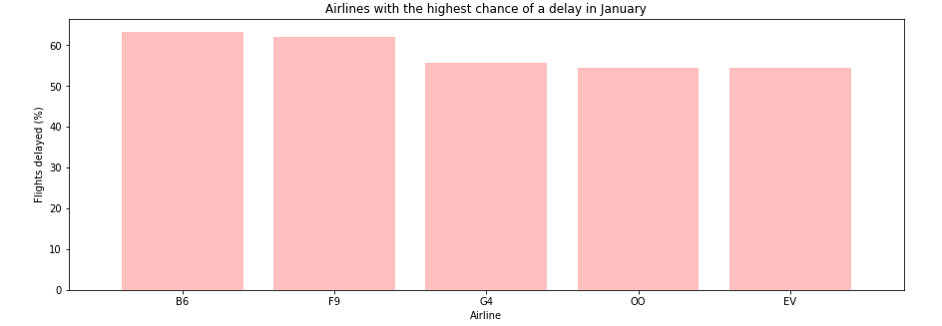

Slide 4
Data
Kaggle – January 2019 US Flight Delays
Cleaned the Data
Created a Pipeline
One_Hot_Encoder
MinMaxScaler
Feature_Selection
Important for Predicting
Models Used
Gradient Boosting Classifier
Random Forest Classifier ( Two Models)

Slide 5
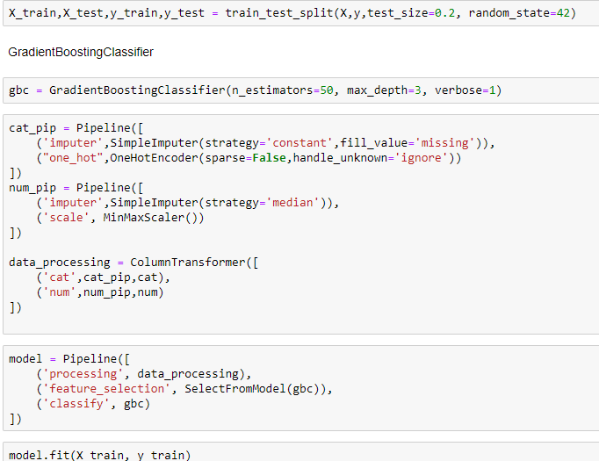

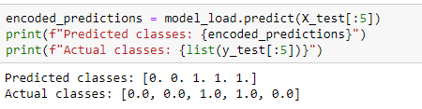
Gradient Boosting Classifier
Building the Model
Results
Prediction

Slide 6
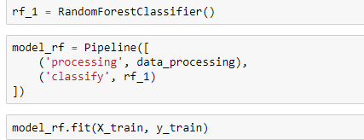
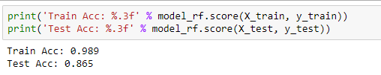
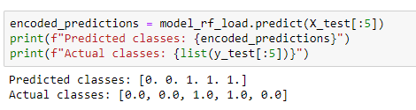
Random Forest Classifier ( 1st Model)
Building the Model
Results
Prediction

Slide 7
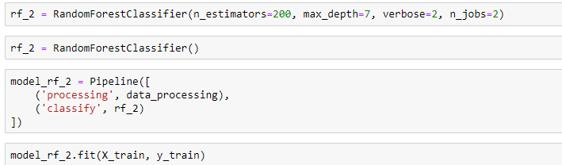

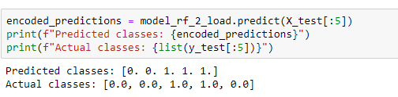
Random Forest Classifier ( 2nd Model)
Building the Model
Results
Prediction

Slide 8
Extreme Gradient boosting Classifier
Building the Model
Results
Prediction

